Slide 1

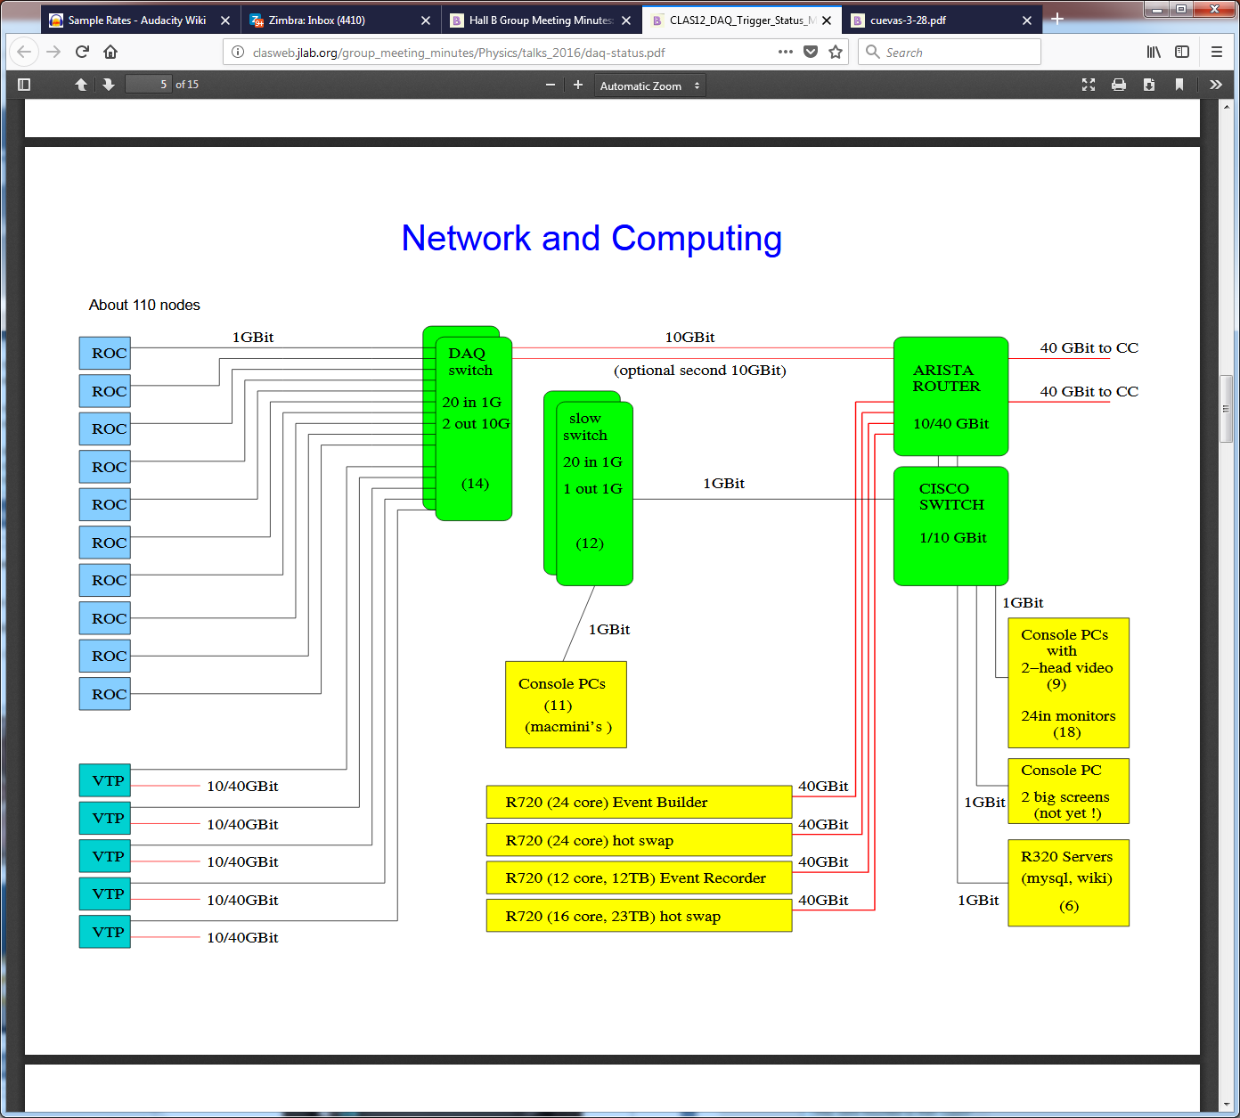

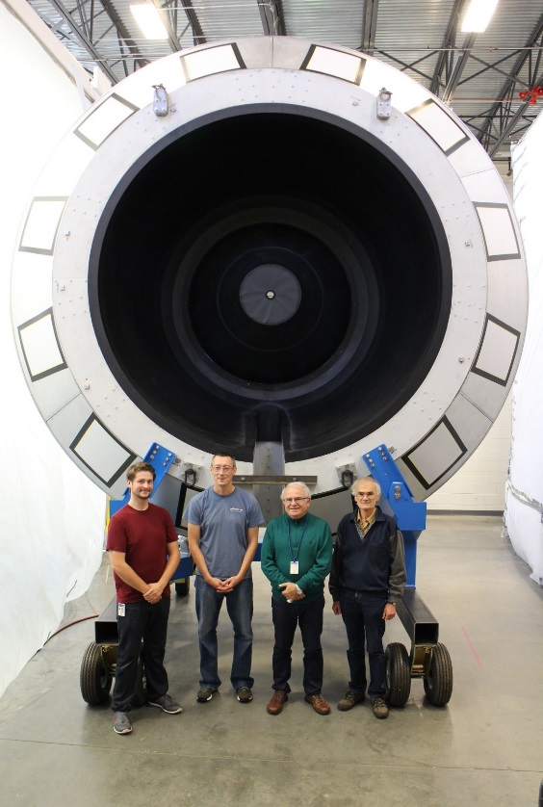
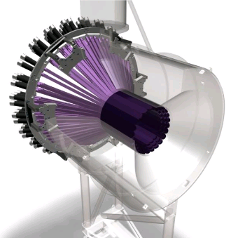
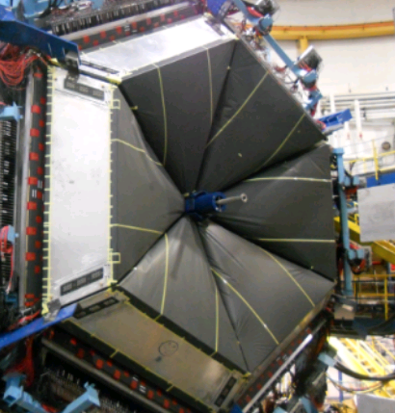
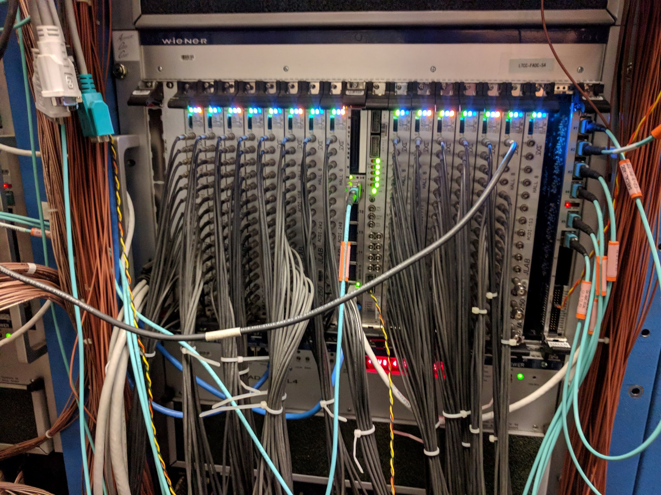
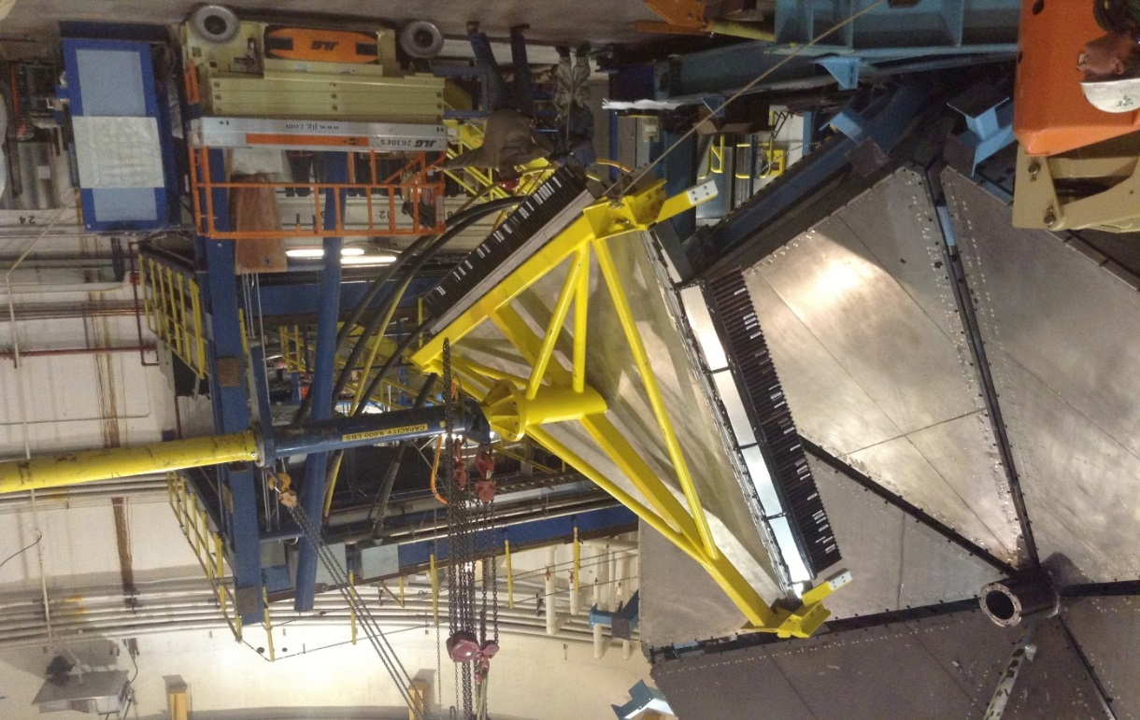
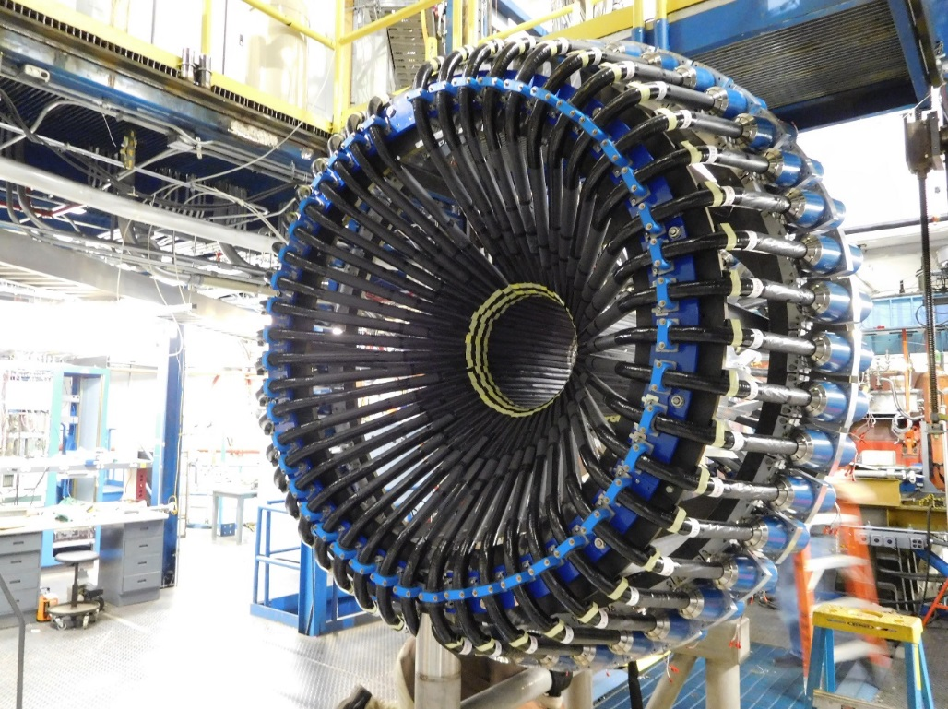
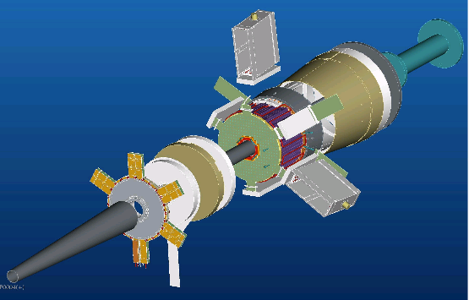
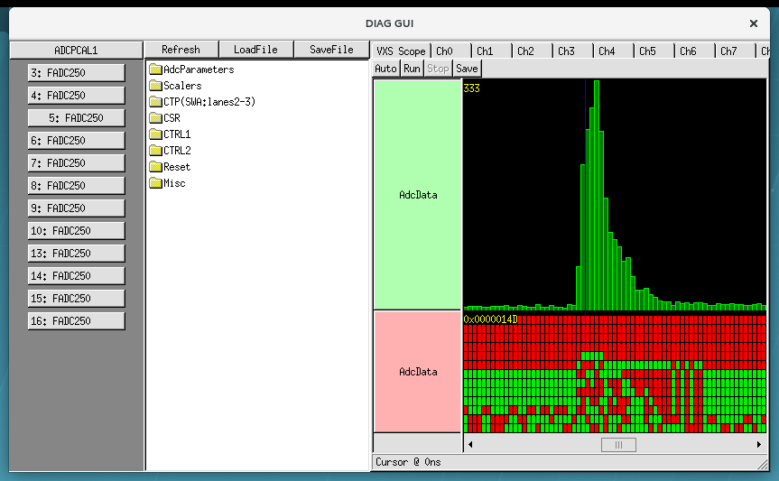
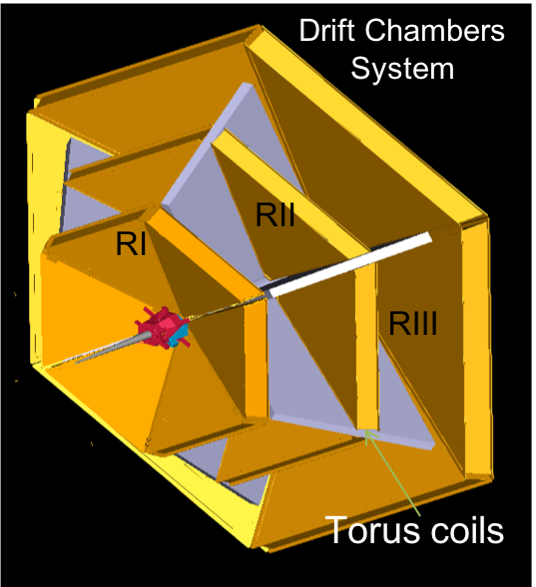
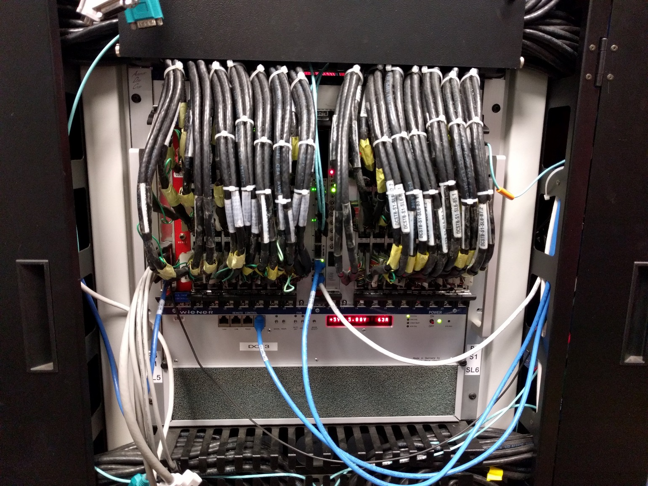
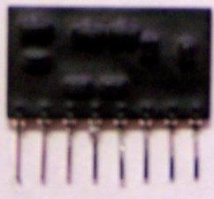
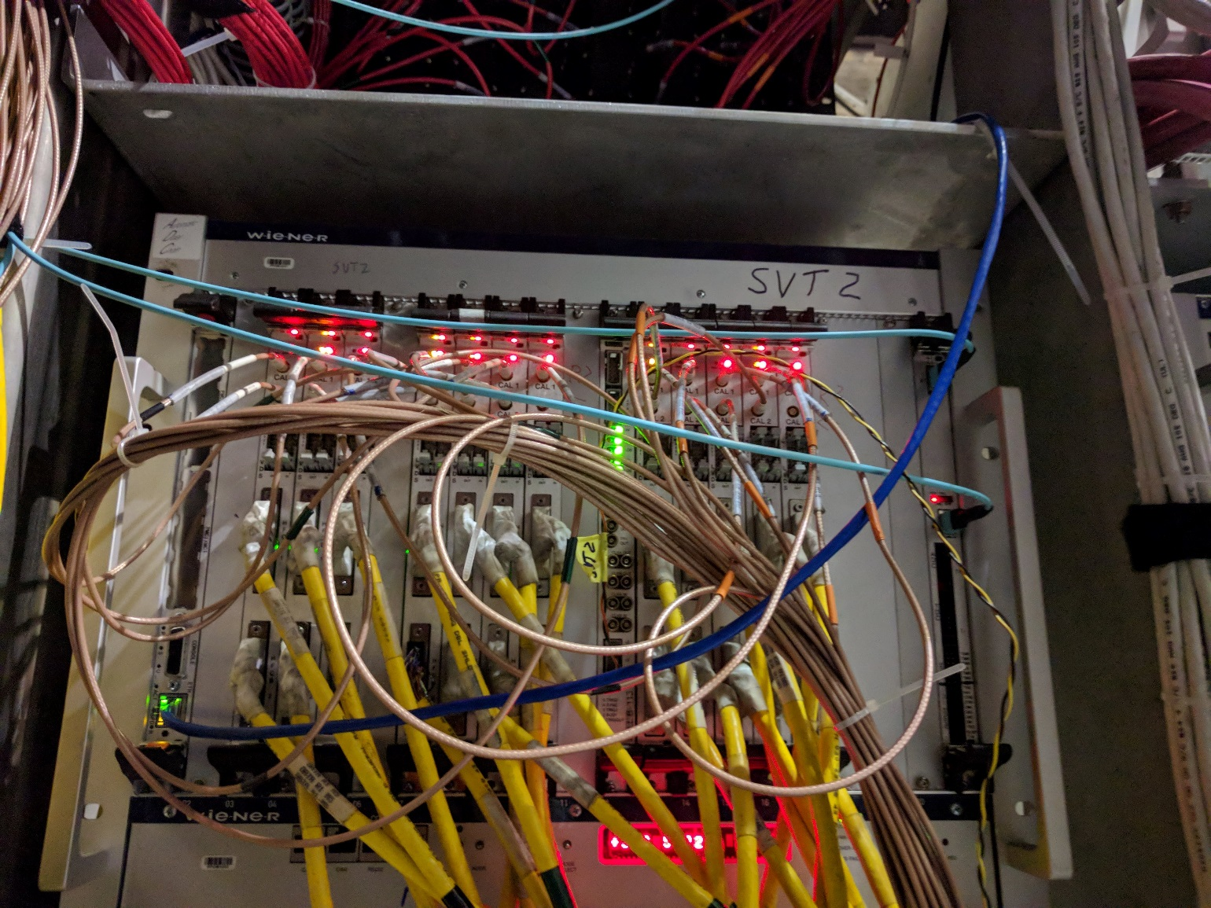
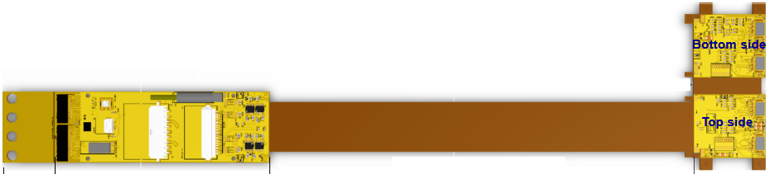
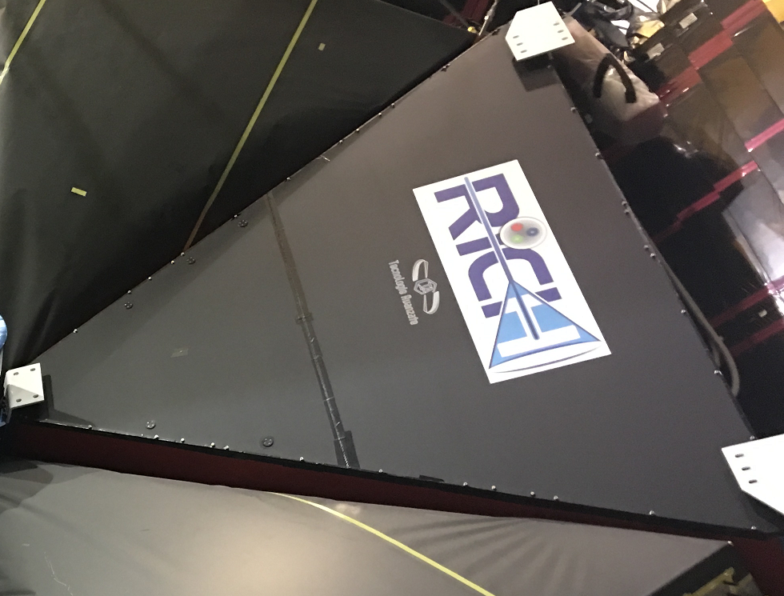
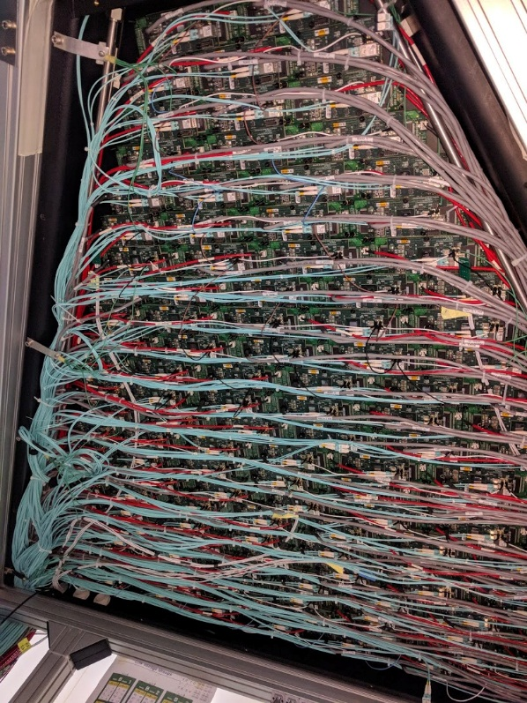
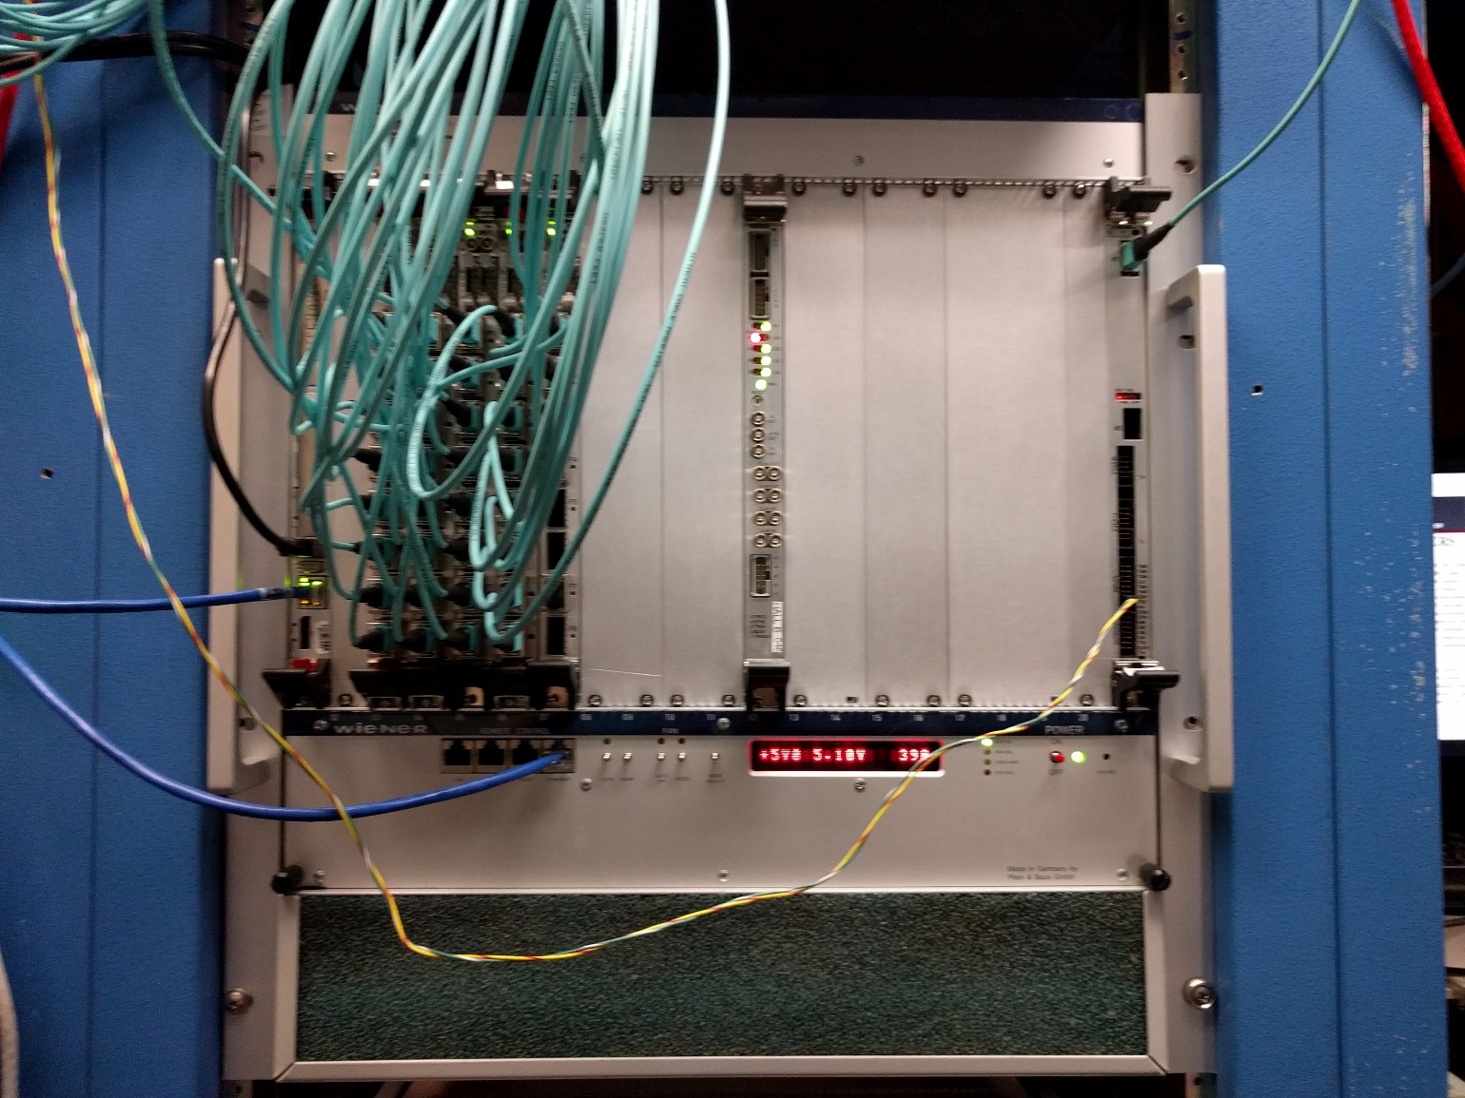
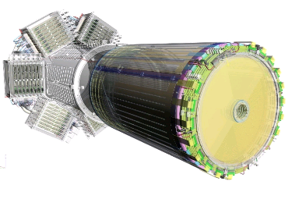
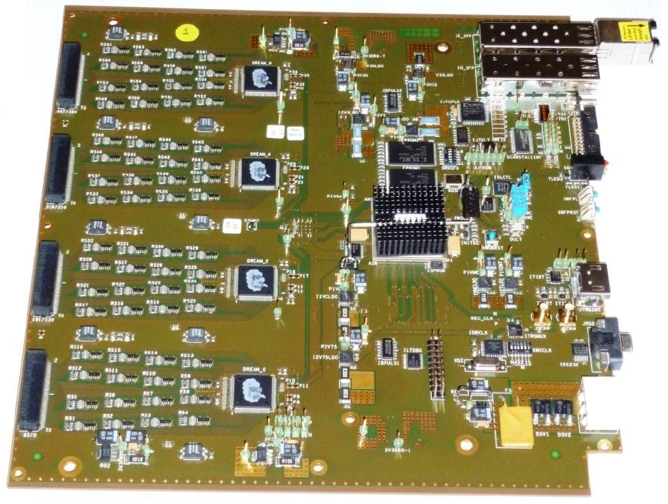
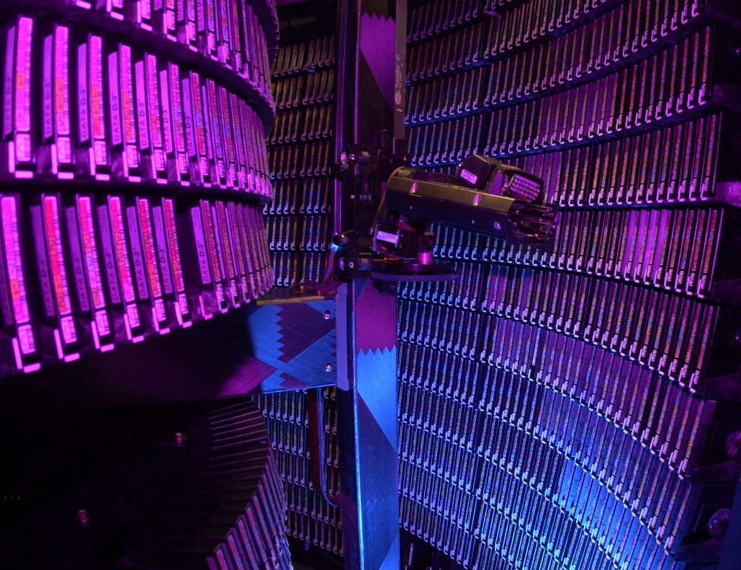
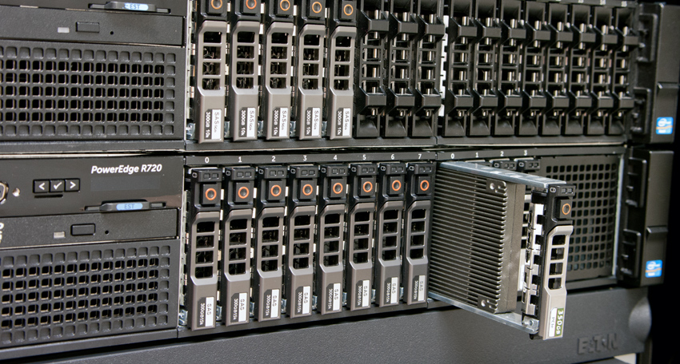
Data Acquisition Electronics
Thomas Jefferson National Accelerator Facility
Think Fast!
Did you know?
Data acquisition (DAQ) electronics capture electrical signals from all of the experimental detectors, select the data of interest, and record it so it can be analyzed in detail to reconstruct physics events. All in a few billionths of a second. In particular:
It selects events of interest from a data flow of 2Tb/s
It records triggered events at up to 20kHz – from nearly 100,000 different detector channels
It records data to disk at up to 1GByte/sec 24 hours a day
The Flash Analog to Digital Converter (FADC250) samples analog voltages 250 million times per second. Hall B has over 4,000 channels. This is an enormous bandwidth: 1 million megabytes per second. It is the equivalent of streaming 300,000 Ultra HD (4K quality) movies at the same time.
Some of the fastest links used at JLab send electrical or optical pulses as narrow as 1/10 of a billion of a second to transmit a single bit of information
At JLab we use custom electronics to synchronize all detector channels. This is done using hundred of fiber optic cables and precision electrical circuits so all modules have count together – with relative time measurement error less than a few trillionths of a second.
Photo-sensors and FADC readout detectors
High Threshold Cherenkov
(HTCC)
Number of channels: 48
Raw data rate: 18GB/s
Triggered data rate: 9MB/s
Central Neutron Detector
(CND)
Number of channels: 144
Raw data rate: 54GB/s
Triggered data rate: 28MB/s
Low Threshold Cherenkov
(LTCC)
Number of channels: 144
Raw data rate: 54GB/s
Triggered data rate: 15MB/s
FADC250 Readout Specs in CLAS12
Sample rate: 250MHz
Voltage resolution: 122µV
24 Crates (crate picture shown above)
250 FADC modules
4000 FADC channels
Electromagnetic Calorimeter
(EC)
Number of channels: 1800
Raw data rate: 675GB/s
Triggered data rate: 160MB/s
Forward Time of Flight
(FTOF)
Number of channels: 1080
Raw data rate: 202GB/s
Triggered data rate: 168MB/s
1.2TB/s
450MB/s
Central Time of Flight
(CTOF)
Number of channels: 96
Raw data rate: 36GB/s
Triggered data rate: 18MB/s
Forward Tagger
(FT)
Number of channels: 448
Raw data rate: 168GB/s
Triggered data rate: 72MB/s
A single crate of FADC readout electronics is show – up to 256 analog inputs that each sample voltage at a rate of 250MHz.
The waveform shows data from FADC250 that was captured from a cosmic ray signal from a single channel/PMT
(in the EC detector).
50mV
268ns
Specialized readout detectors
Drift Chamber
(DC)
Number of channels: 24192
Raw data rate: 3024GB/sec
Triggered data rate: 90MB/s
Some detectors have so many channels that special electronics are designed right on the detector – this is to improve performance and reduce cost. For example, using the same FADC250 above for all detectors below would increase the DAQ cost by 100 times.
Drift Chamber SIP
Qty 24192 – each about the size of a penny
They amplify and convert the currents in the drift chamber wires to voltage pulses as small as ~1mV
90MB/s
3024GB/s
Silicon Vertex Tracker
(SVT)
Number of channels: 21504
Raw data rate: 18GB/s
Triggered data rate: 15MB/s
Hybrid Flex Circuit Board
Qty 42 – extremely fine pitch circuit that read 512 channels
They amplify and convert the tiny currents in silicon and digital them sending over high speed copper wires
924GB/s
18GB/s
15MB/s
Ring Imaging Cherenkov
(RICH)
Number of channels: 25024
Raw data rate: 3128GB/s
Triggered data rate: 15MB/s
RICH Readout Stack
Qty 138 – All 138 modules shown, each module amplify 192 PMT channels and measures the time with an accuracy of 1ns! This data is send over 138 high speed fiber optic links.
3128GB/s
345Gb/s
15MB/s
Micromegas Vertex Tracker
(MVT)
Number of channels: 21000
Raw data rate: 630GB/s
Triggered data rate: 150MB/s
MVT Front-End-Unit
Qty 41 – Each module amplify 512 channels and measures the full waveform of each pulse. This data is send over 41 high speed fiber optic links.
3128GB/s
100GB/s
150MB/s
Contributing Institutions
High channel count & specialized readout detectors
Jefferson Lab, Newport News, VA, USA
INFN, Ferrara, Italy
IRFU, CEA Saclay, France
Tape storage is still the most cost effective way at JLab to store the massive amount of data generated by the experimental halls. This can be well over 100TB per day!
Powerful servers piece data streams from different detectors together and store data to disk temporarily (typically less than 1 day), before the data is moved to a tape library.
720MB/s

